Slide 1

英语学术口语
凌斯达

Slide 2

目 录
01
我是谁？
02
关于中国同学口语的一点想法
03
如何准备英语学术口头报告
04
Rule of thumb

Slide 3



01
我是谁？

Slide 4



01
我是谁？
曾任国际学生学者中心助理，化工系国际助理，校庆专项办助理，“英文学术写作与交流”助教等职务；
曾获得McGill Entrance Scholarship, 两次加拿大自然基金委本科科研奖学金，我最喜欢喝奈雪了，两次魁北克自然基金委本科科研奖学金，魁北克自然基金委研究生奖学金，中国政府奖学金等荣誉；
曾任校研会国际部副部长，撰写“世界青年气候变化宣言”在联合国气候变化大会发表并被多家主流媒体报道；英雄联盟太菜了；曾任Engineers Without Borders副主席，致力于可持续化工程教育和西非工程类慈善项目建设；
曾创办“清华说”协会，并发展成校园最大的国际学生社团；
精通中英法三种语言，过去四年担任多家中介与培训机构英法文书老师，毕业旅行去哪儿呢，雅思口语老师，对于辅导中国学生英语沟通有较丰富的经验；
Keyword
凌斯达 化学工程系硕士研究生
4

Slide 5
02
关于中国同学英语口语的一些想法。。。
不敢说，不会说，没的说

Slide 6
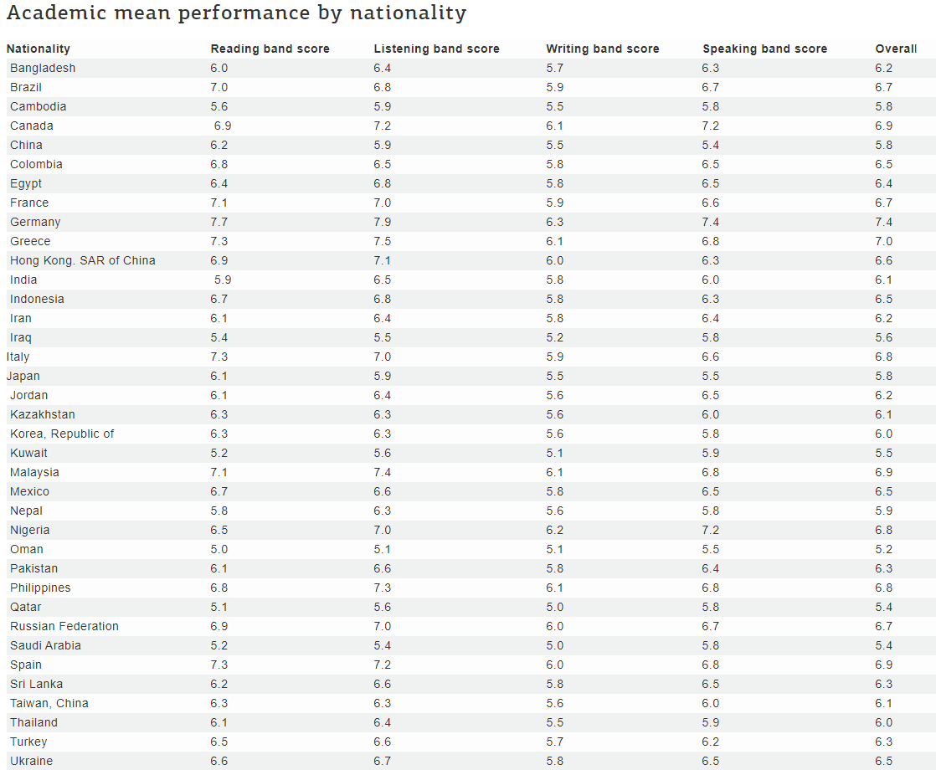
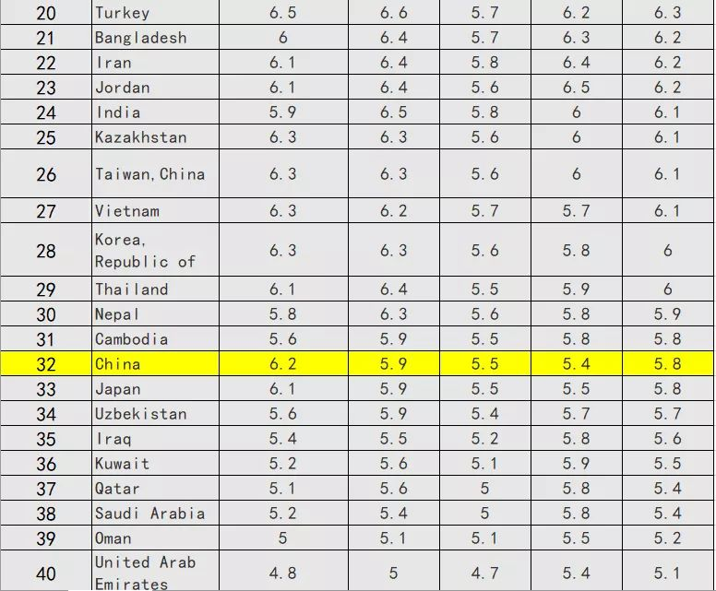
02
大饼卷翻天：雅思口语卷起来
中国考生雅思口语成绩全球倒数第一！
6

Slide 7
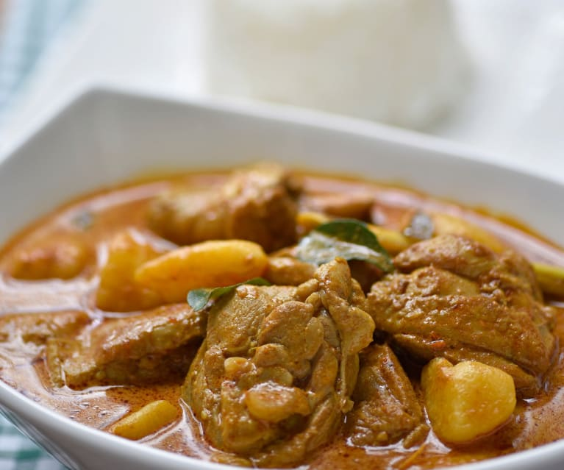
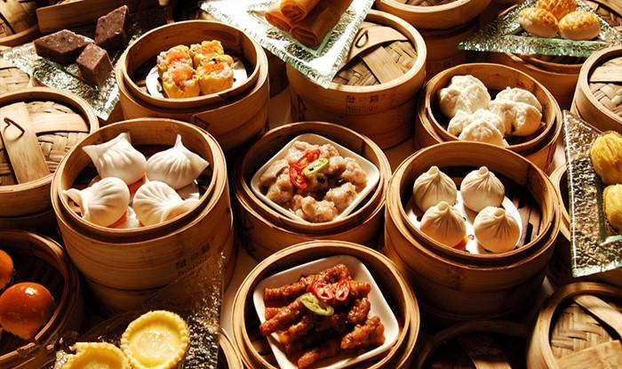
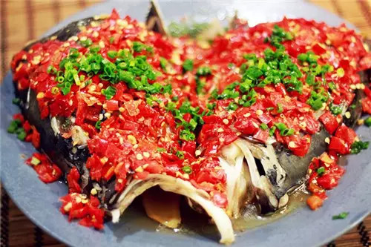
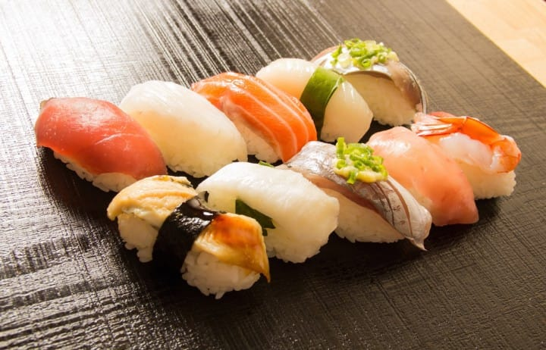
02
口音是问题吗？
为什么要克制自己？
说啊！！！
广东普通话
咖喱味英语
寿司味英语
湖南普通话
7

Slide 8
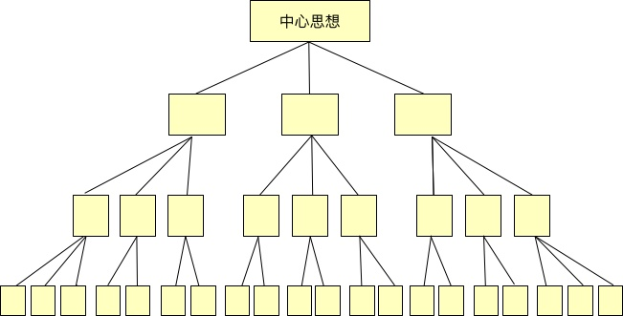
02
思维，思维，还是思维！
In English, the responsibility of the delivery lies on the author/speaker.
9

Slide 9
02
如何组织语言
1. Funnel举例法
2. Definition举例法
3. WH拓展法
4. Parallel扩展法
基本思路：
首先给出statement
再给出explanations去解释statement
通过举例去支撑explanations
10

Slide 10
02
如何组织语言
Funnel举例法
Q: What do you like to do in your free time?
低情商 Answer: I like to read.
高情商 Answer: I enjoy reading books in my free time, especially historical novels like The Golden Lotus AND Romance of the three Kingdoms. I find those stories fascinating, and often get inspired.
Step 1: 给一个笼统类型的答案
Step 2: 降落到一个精准类型的答案
Step 3: 给予你自己的观点
（You can also play around with it）
11

Slide 11
02
如何组织语言
2. Definition举例法
Q: Do you know any inspiring person?
低情商 Answer: Yes, I know.
高情商 Answer: Yes, a very inspiring person whom I know is my Master supervisor Professor Jianhong Xu. Professor Xu is not only knowledgeable in his own research field, but also acts as my life mentor. I remember when I was very depressed about my research, he tried to cheer me up with his own miserable graduate student experience.
Step 1: 给一个确定答案
Step 2: 给出一个定义
Step 3: 用一个例子去支撑
Do you like Donald Trump?
12

Slide 12
02
如何组织语言
3. WH扩展法
Q: What kinds of outdoor activities do you like to do?
低情商 Answer: I like to play soccer.
高情商 Answer: I enjoy playing soccer outside with my college friends on sunny days. I get a good kick out of sweating and it would help keeping my body in shape.
Step 1: What
Step 2: Who
Step 3: When
Step 4: Where
Step 5: Why/How
(you can play around with it)
What kind of movies do you like to watch?
13

Slide 13
02
如何组织语言
4. Parallel扩展法
Q: What do Tsinghua students like to do?
低情商 Answer: Tsinghua students like to study.
高情商 Answer: Well, it really depends. Some students like to study and always stay in library to acquire new knowledge. Some students like to make new friends so they participate in a lot of student activities.
展开的逻辑标语：
Firstly, For one, The main factor is.., one of the reasons is…. For starters..
扩展性的：
What’s more, in addition, as well as, most importantly, and also partly because, furthermore, Moreover, apart from that
What kind of transportation do you usually take for traveling?
14

Slide 14
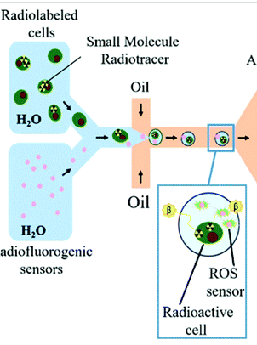
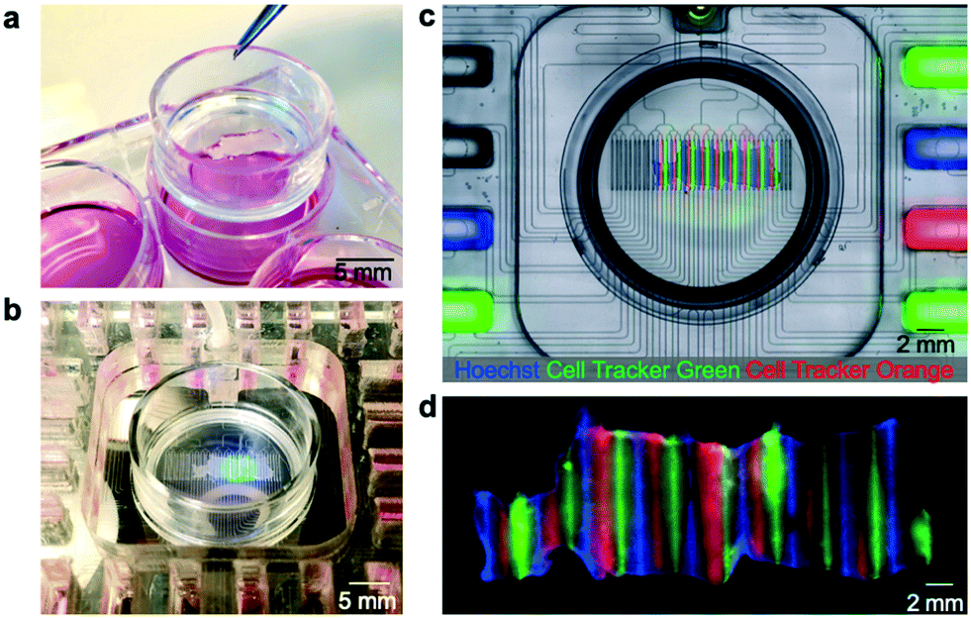
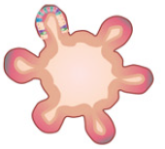
02
如何组织语言
那么现在套用在学术报告上呢？
Nature Reviews Genetics volume 19, 671–687(2018)
Analyst, 144, 766-781 (2019)
Lab Chip, 20, 1658-1675, (2020)
这样我们就可以利用这个很牛逼的技术去控制细胞，用于测试细胞对于各种药物的反应了。
我有一个技术，叫做微流控技术。它很牛逼，因为它能够快速、精准控制很小的液体。
我想要用这个技术去包裹人类的细胞。
15

Slide 15
02
如何组织语言
那么现在套用在学术报告上呢？
Funnel举例法:
People have paid significant amount of efforts, in recent year, to investigate the application of microfluidic technology in various research and industrial fields, notably for biomedical engineering. In fact, the controllability of the microfluidic system is especially suitable for handle biological sample, which are very delicate and sensitive. Its high-throughput also enables its application for clinical drug screening or other cellular testing.
16

Slide 16
02
如何组织语言
那么现在套用在学术报告上呢？
Definition举例法:
Microfluidic technology is a method that enables the precise control of minimal amount of fluid at a very high throughput. Because of the inherent high controllability and high-throughput of the microfluidic technology, it has been widely applied in the field of biomedical engineering in recent years. Notably, I use the microfluidic technology to encapsulate cell, and use the encapsulated cells as a tool to screen drugs.
17

Slide 17
02
如何组织语言
那么现在套用在学术报告上呢？
WH举例法:
In my research, I use the microfluidic technology to encapsulate cell within microdroplets at a very high throughput. Because the inherent controllability of the microfluidic technology, I can precise control and manipulate encapsulated cells, and use them to screen drugs.
18

Slide 18
02
如何组织语言
那么现在套用在学术报告上呢？
Parallel举例法:
In my research, I use the microfluidic technology to encapsulate cell within microdroplets for the purpose of drug screening. On the one hand, the precise controllability of the microfluidic system is very suitable for manipulating delicate and sensitive biological samples like cells. On the other hand, the high throughput of the microfluidic technology enables its application in clinical and commercial scenario.
19

Slide 19
02
小结
口音不是问题！思维逻辑才是！
几个组织语言的句式结构
1. Funnel举例法
2. Definition举例法
3. WH拓展法
4. Parallel扩展法
20

Slide 20
03
如何准备英语学术口头报告

Slide 21
03
成功的口头报告三大要素
Step 1: Prepare carefully
Step 2: Practice often
Step 3: Perform with enthusiasm
22

Slide 22
03
英语学术报告就是那么点事儿
英语学术报告三部曲：
Step 1: Tell your audience what you will tell them
Step 2: Tell your audience what you want to tell them
Step 3: Tell your audience what you have told them
23

Slide 23
03
道理我都懂，但臣妾做不到啊
开始准备英语学术报告。。。之前！注意：
1）了解你的听众！永远不要高估他们的背景，但也不要低估他们求知的渴望！
2）默念三遍，端正心态：the responsibility of delivery lies on myself!
24

Slide 24
03
准备阶段的一点小建议
英文学术口头报告跟英文学术写作有什么区别？
1）跟阅读不同，听众不能自由的回溯已经传递过的信息。
2）听众不能长时间集中精神。
针对这两点，在准备讲稿的时候：
1）不要写长难句！这会让听众迷糊+分神！
2）表述可以口语化，但这毕竟是一个学术报告，用词尽量formal。例如get, awesome, things这些词尽量避免。也少用filler words。
3）谨慎使用代词pronoun, 毕竟听众没有你熟悉讲稿！
25

Slide 25
03
终于可以开始做PPT了
最最最最重要的一点是：never crowd your slide!!!
26

Slide 26
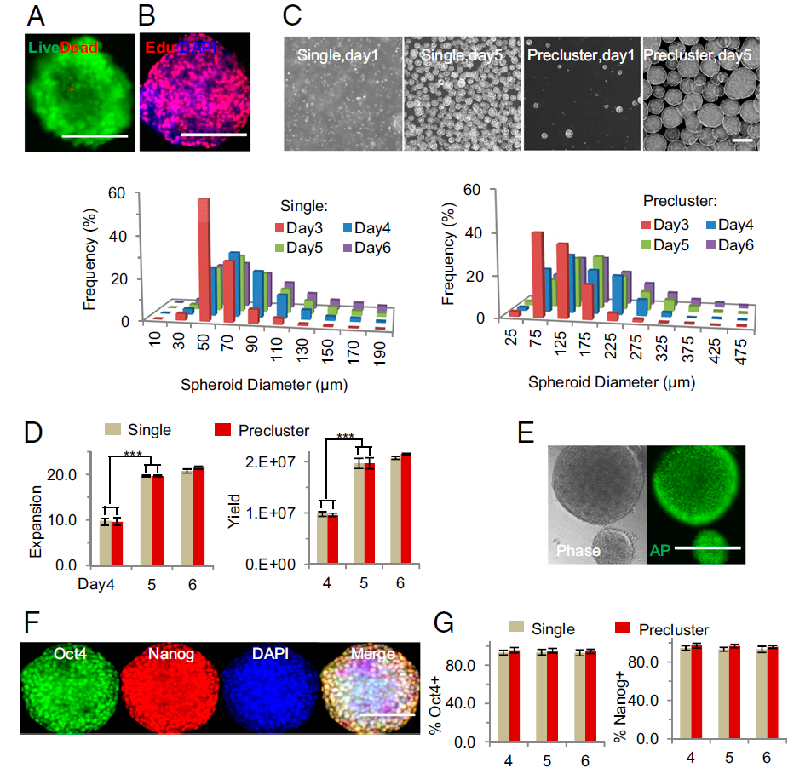
03
你给我的爱我承受不来
Human pluripotent stem cells (hPSCs), including human embryonic stem cells and induced pluripotent stem cells, are promising for numerous biomedical applications, such as cell replacement therapies, tissue and whole-organ engineering, and high-throughput pharmacology and toxicology screening. Each of these applications requires large numbers of cells of high quality;
however, the scalable expansion and differentiation of hPSCs, especially for clinical utilization, remains a challenge.
We report a simple, defined, efficient, scalable, and good manufacturing practice-compatible 3D culture system for hPSC expansion and differentiation. It employs a thermoresponsive hydrogel that combines easy manipulation and completely defined conditions, free of any human- or animal-derived factors, and entailing only recombinant protein factors.
Under an optimized protocol, the 3D system enables long-term, serial expansion of multiple hPSCs lines with a high expansion rate (∼20-fold per 5-d passage, for a 1072-fold expansion over 280 d), yield (∼2.0 × 107 cells per mL of hydrogel), and purity (∼95% Oct4+), even with single-cell inoculation, all of which offer considerable advantages relative to current approaches.
Moreover, the system enabled 3D directed differentiation of hPSCs into multiple lineages, including dopaminergic neuron progenitors with a yield of ∼8 × 107 dopaminergic progenitors per mL of hydrogel and ∼80-fold expansion by the end of a 15-d derivation.
This versatile system may be useful at numerous scales, from basic biological investigation to clinical development.
PNAS, 110 (52) E5039-E5048
27

Slide 27
03
你给我的爱我承受不来2
曾任国际学生学者中心助理，化工系国际助理，校庆专项办助理，“英文学术写作与交流”助教等职务；
曾获得McGill Entrance Scholarship, 两次加拿大自然基金委本科科研奖学金，我最喜欢喝奈雪了，两次魁北克自然基金委本科科研奖学金，魁北克自然基金委研究生奖学金，中国政府奖学金等荣誉；
曾任校研会国际部副部长，撰写“世界青年气候变化宣言”在联合国气候变化大会发表并被多家主流媒体报道；英雄联盟太菜了；曾任Engineers Without Borders副主席，致力于可持续化工程教育和西非工程类慈善项目建设；
曾创办“清华说”协会，并发展成校园最大的国际学生社团；
精通中英法三种语言，过去四年担任多家中介与培训机构英法文书老师，毕业旅行去哪儿呢，雅思口语老师，对于辅导中国学生英语沟通有较丰富的经验；
Keyword
凌斯达 化学工程系硕士研究生
28

Slide 28
03
做PPT要点
如何避免crowded slides?
  每页PPT只说明一到两点：不要高估听众的背景！
  如果你不会讲到某个信息，那就不要放上去！！！
  保证每页PPT都有说明图片和文字，从文字、视觉和听觉三个方面传递信息
29

Slide 29
03
做PPT要点
字体
  大于18号（引用可以使用14号）
  尽量使用Sans Serial Font:
    This is an Arial Font
    This is a Times New Roman Font
  字体颜色与背景颜色：背景颜色/图案尽量简单，字体颜色与背景颜色对比度强
  背景颜色可以考虑报告内容和环境做适当调整
自强不息
厚德载物
自强不息
厚德载物
自强不息
厚德载物
30

Slide 30
03
做PPT要点
说明文字
  每一段说明文字不易超过两行
  再说一遍：不要高估你听众的背景！记得给予听众充分的背景知识和名词解释。
  不要用数据把你的听众淹没
  重要的事情说三遍！！！不断地重复你认为重要的信息，这样你的听众才会知道这很重要！
    Something is only important when you said it is important…
31

Slide 31
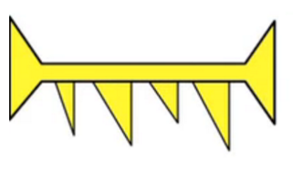
03
做PPT要点
学术报告流程：手把手地带领听众了解你的领域
Home image/graphics
Analyst, 144, 766-781 (2019)
32

Slide 32
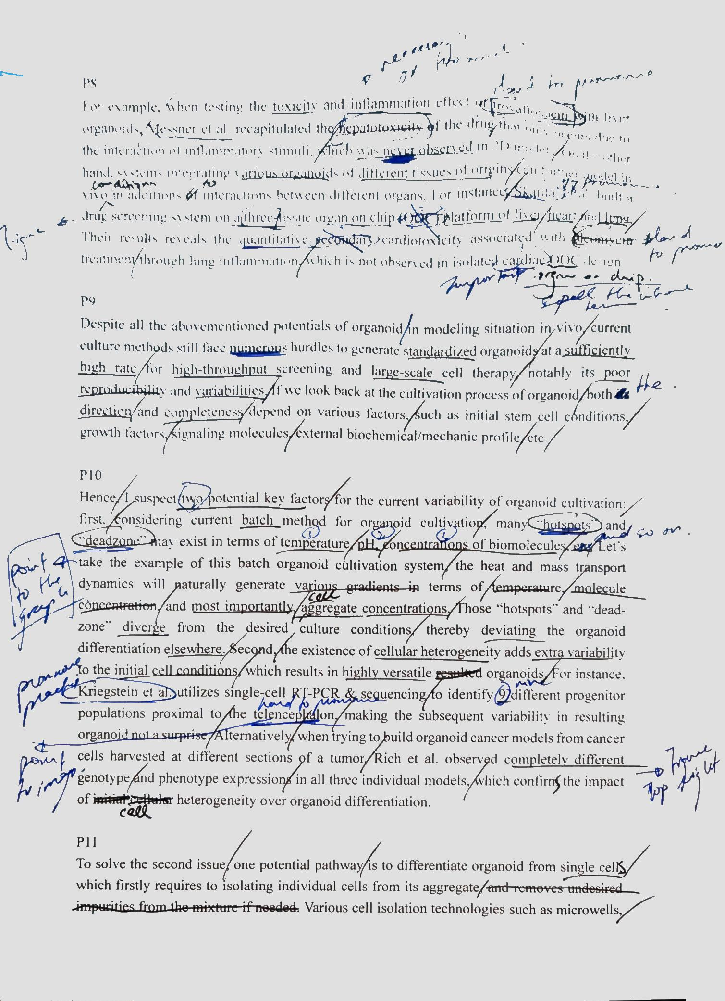
03
Practice, Practice, Practice
练习是一个成功报告的关键
  大声的自己练习
  把自己的练习记录下来
  在朋友、同事面前联系
练习的时候最重要的一点:
请你把听众当人吧！
请你做个人吧！
33

Slide 33
02
小结
永远不好高估听众的背景！
不要让你的PPT太拥挤。
不要用数据或者细节把你的听众淹没。
波浪式演讲节奏
做个人吧！！！
34

Slide 34
04
RULE OF THUMB

Slide 35
04
多些套路
  Greeting everyone
    Good morning/good evening/hello everyone, welcome to my presentation/thank you for taking time to listen to my presentation;
  Self-introduction
    My name is Si Da Ling, and I am a Master student from Department of Chemical Engineering of Tsinghua University, it is my great pleasure today to present you my recent work on …./the topic of my presentation is…
  Present the agenda of your presentation
    I am going to focus on/look at/deal with three main points…
    I’ve divided my presentation into three main parts
    First of all, I will talk about… Second, we will look at…and finally, I will explain/show you/tell you about

Slide 36
04
多些套路2
  Question
    There will be plenty of time for question at the end of my presentation.
    I’d appreciate it if you could leave any questions you may have until the end of my presentation
    If you have any questions during the presentation, feel free to interrupts at any time.
  Introduction
    I’d like to begin by/telling you/showing your…
    Let’s start with…
  Finishing a section/topic
    So that conclude my first point…
    Let’s summarize real quick my key points in my first section…
    If we recap the first section…
  Change to another section
    Now, let’s move on to my next topic, which is

Slide 37
04
多些套路3
  Change to another section
    Now, let’s move on to my next topic, which is…
    Let’s turn now to/moving on to…
  Refer to graphs
    As you can see on this chart/graph on top left/top right/bottom left/bottom right…
    Take a look at this chart/graph …
    This graph clearly shows..
    This graph highlights …
  Reminding your audience
    As I have explained at the beginning…
    This relates to what I was saying earlier
    This ties in with what I said at the start of my presentation…
    If we recall what I have mentioned earlier…

Slide 38
04
多些套路4
  Summarizing & Concluding
    So that brings me to the end of my presentation…
    We looked at three main points. First I showed you/spoke about…Then we looked at… And finally I explained/told you about
    To conclude, I’d like to say
    Before we finish, I’d like to leave you with one final thoughts/some take-home messages…
  Thanking & Inviting to ask questions
    Thank you very much for your attention/time
    Thank you for listening
    If you have any question, I’d be happy to answer them now

Slide 39
04
多些套路5
  Responding to questions
    如果你知道答案：That is a great/excellent question…
    如果你不知道答案，但是问题很有价值：That is a very interesting question and it is definitely worth answering because.... However, I don’t have data at the moment/I haven’t looked into it before, so I cannot answer you right now. I would like to discuss with you/I suggest you to look into XXX…
    如果这个问题有点无厘头：Thank you for your question, if you look into … (try to deviate the question to your emphasis)
  如何搭讪大佬
    “偶遇大佬”：Hello Professor XXX, very nice to meet your. I am XXX from XXX university and I am currently working on XXX. I attended your seminar on the other day and I am very interested in your work on….
    大佬在跟其他人谈话: I am sorry to interrupt. Hello I am XXX from XXX university…

Slide 40
谢谢大家！
Q&A

